Slide 1
ASSIGNMENT 2
Presented by group 3 members

Slide 2
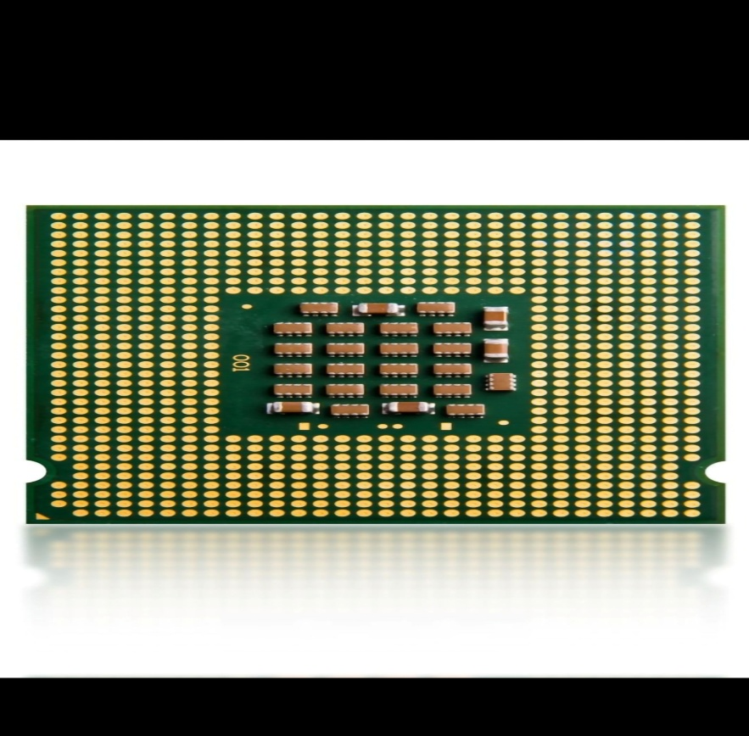
CENTRAL PROCESSING UNIT (C.P.U)
A C.P.U is the main processing component of a computer that executes instructions, performs calculations and controls all other operations of a computer.
In simple terms, a C.P.U is a brain of a computer.

Slide 3
SIMPLE DIAGRAM CENTRAL PROCESSING UNIT (C.P.U)
CENTRAL PROCESSING UNIT (C.P.U)
CONTROL UNIT (C.U)
INPUT
OUTPUT
ARITHMETIC LOGIC UNIT (A.L.U)
REGISTERS

Slide 4
EXPLANATION
Control Unit(C.U);It controls and coordinates activities of a computer. It interprets instructions and directs other parts of the C.P.U.
Arithmetic Logic Unit; Performs arithmetic calculations such as addition, subtraction, multiplication and division. It also performs logical comparisons.
Registers; these are ultra fast temporary storage locations inside the C.P.U. they hold data currently being processed and instructions being decoded.

Slide 5
COMPUTING TERMS
A computer network; Is a collection of interconnected computers and devices which share information and other resources. Such devices include printers and servers using wireless connections such as Wi-Fi, LAN,etc
Internet is a global system of interconnected networks. Examples of networks include ; browsing websites like google, etc.
Network topologies; is a structural arrangement of computers in a network.

Slide 6
TYPES OF TOPOLOGIES
Bus topology
Star topology
Tree topology
Mesh topology
Ring topology

Slide 7
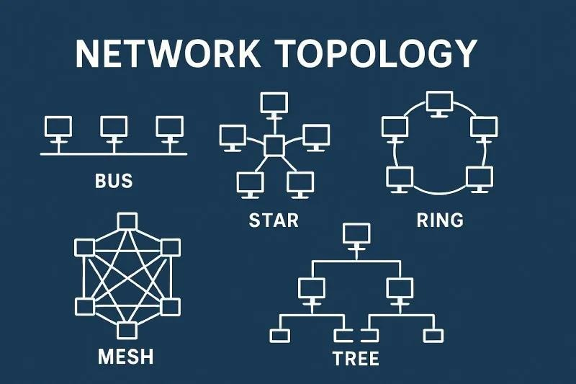
TYPES OF NETWORK TOPOLOGIES

Slide 8
WHO OWNS THE INTERNET
It’s a massive decentralized collection of independently owned networks that choose to connect and speak to each other.
Infrastructure owners of the internet include;
Telecom companies like MTN, etc.
Tech giants
Microsoft
Google, etc.

Slide 9
COMPONENTS OF INTERNET INFRASTRUCTURE
Routers; these are traffic guides that read packets and pick the fastest path between different networks.
Transmission media; these include optical fibers and undersea cables which high capacity glass threads that move data using light across countries and oceans at extreme speeds
Servers; powerful computers housed inside data centers that store websites, run cloud apps, and deliver content to users.

